Slide 1

UTour
A new way to enjoy your travelling experience
Notes:
Hi, I’m Brian- and this is Andrew, Jeffrey, Gavin, Caleb and Birathan...and we are Baba’s ToolBox.
We are here today to propose our latest innovation, UTour. A way for travelers to plan and manage their travel experience.

Slide 2


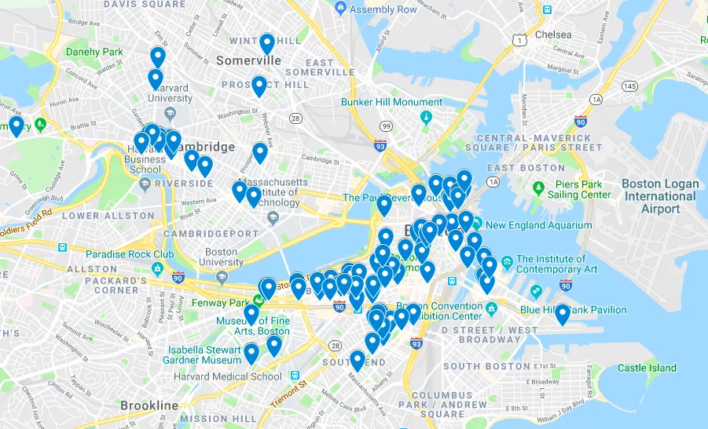

What is UTour?
Plan
Travel
Recommend
Notes:
Before we dive deeper into our application, let me give a short introduction.
UTour is an application that allows users to plan out their trip, find the best attractions and leave recommendations.
It’s designed to be an easy way for both veteran and beginner travelers to explore the world.

Slide 3
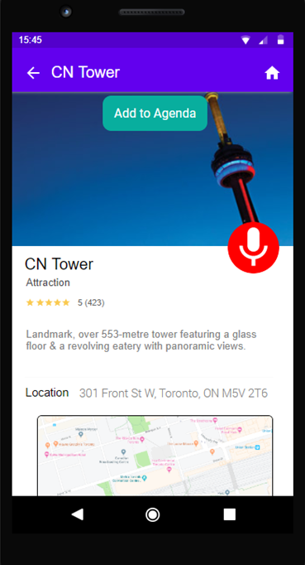




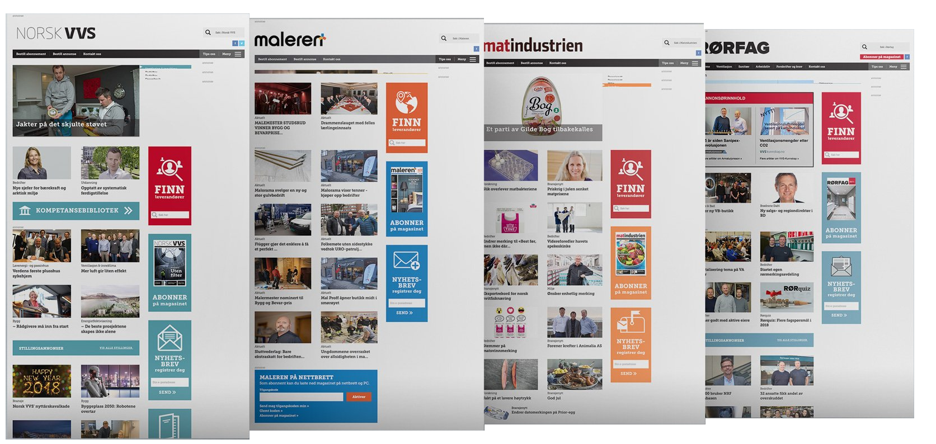
Our Motivations
UTour
Conventional Planning
Notes:
Why did we decide to create an application for traveling?
We understood the hassles travelers face when organizing and planning trips, as well as problems that can arise when touring places. Instead of a simple, straightforward option made available, users often have to go through multiple websites, applications and blogs before finalizing a travel plan.
This led to the creation of UTour, a simple to use mobile application designed to put planning all into one convenient and easy to access location.

Slide 4
The Plan for Today
I
II
III
IV
Identifying
the Problem
Gathering User
Requirements
Solution
Usability Evaluation
Notes:
For today’s presentation, we will be looking at the initial problem, user’s expectations, our proposed solution, and the final evaluation of our prototype.

Slide 5
Identifying the Problem

Slide 6
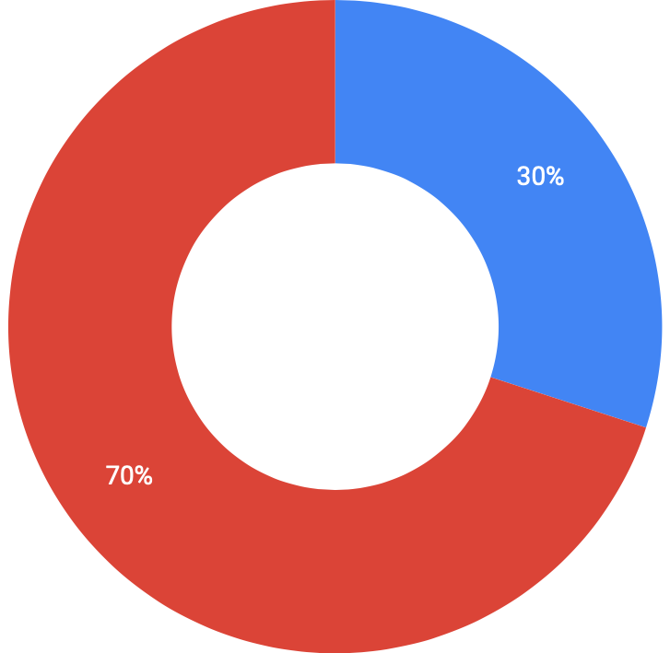
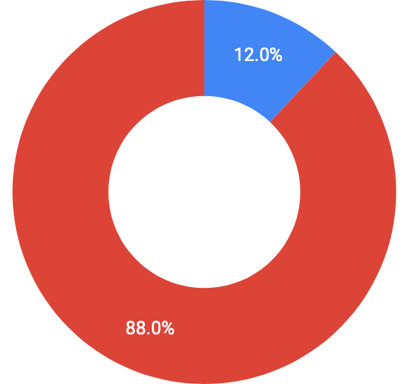
Demographics
70%
88%
70% of smartphone users use their mobile devices to plan their trips
88% of travellers want their favourite trip planning content in one application
Notes:
To identify the problem, we needed to identify our target traveller demographics and their needs.
According to a 2018 survey conducted by Travelport, millennials (ages 18 to 34) planned the most number of trips between 2017 and 2018 than any other age group.
A related study conducted by Google in 2016 showed that 70% of travellers who had a smartphone used their mobile devices to conduct their travel research and planning.
In fact, a Mobile Trends Report released by HubSpot’s in 2018, identified that 88% of travellers would prefer to access their favourite trip planning content all in one app.
Therefore, we determined that our target audience is millennials who actively use their phones to plan a trip and want efficiency in their planning using one app.

Slide 7
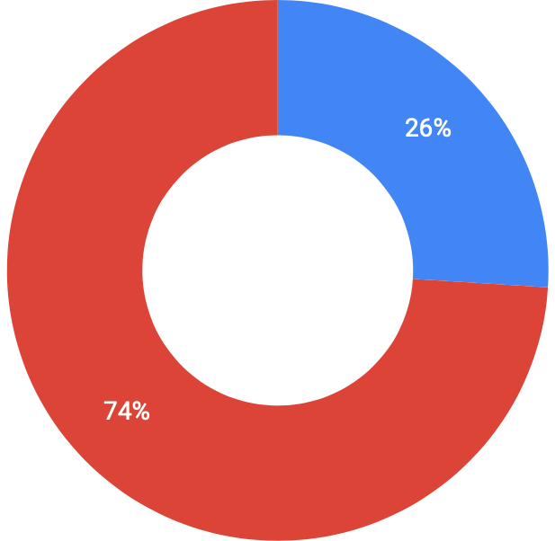
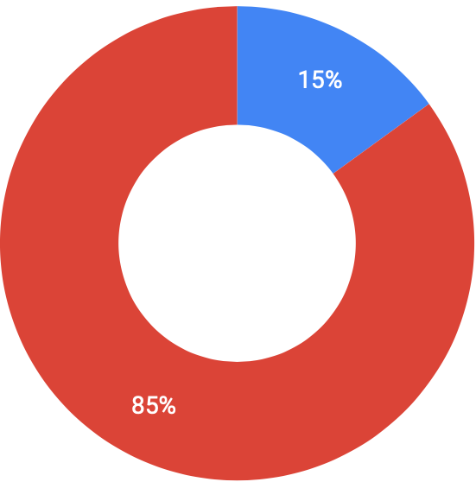
Problem: Trip Planning
74%
85%
74% of trips are destination-led
85% of travelers decide on activities after arriving at their destination
Notes:
This led us to the problem of efficiency and effectiveness in trip planning.
A 2013 study done by TripAdvisor showed travellers would visit more than 38 websites on average to plan their trip.
A related 2016 study by TripAdvisor revealed that 74% of travellers planned their trip by first choosing their destinations which the majority of times were chosen from based on online reviews and/or from a friend's recommendation.
However, a 2016 study by Google suggested that 85% of travellers planned activities only after having arrived at their destination because they were not able to find reliable reviews or recommendations about activities online.
Therefore, we identified a problem of needing an effective one-stop application where travellers can find reliable reviews on travel destinations and local activities to efficiently plan their trip.

Slide 8
Gathering User Requirements
Notes:
Now that we have identified the problem, we need to understand what the users would want to see in the application.

Slide 9
Survey Results
No
12.5%
No
16.7%
Maybe
25%
No
33.3%
Maybe
29.2%
Yes
83.3%
Yes
62.5%
Yes
37.5%
83.3% (20/24) would take customer reviews into consideration before trying something new
62.5% (15/24) believe reading or listening to details about cities/attractions whilst travelling enhances their experience
37.5% (9/24) willing to explore cities/attractions with a group
Notes:
This was done by using a survey, as it was a quick and concise form of obtaining information from potential users.
We asked users about their travel habits such as how often they travelled, the reasons that prohibited them from travelling, whether they think an app like ours would be beneficial to them, and possible features that they would like to see implemented.
From the survey we concluded that an overwhelming 83.3% (20/24) of participants would use customer reviews as a point of consideration before trying something new such as visiting restaurants or attractions.
We also found that 62.5% (15/24) participants believe that being able to read or listen to details about the cities and attractions while on their travels will enhance their overall experience.
Most importantly from the survey, we discovered that only around a third of the participants would actually want to travel with a group, a clear indication that the feature wouldn’t be used much. Thus we decided from this point forward that we will not implement our proposed feature that would match users into a group of other tourists.

Slide 10
Our Solution
Notes:
And now, onto our actual solution to the problem

Slide 11
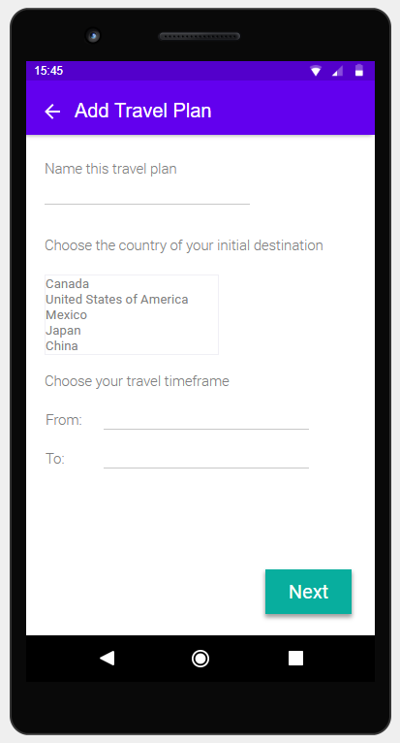
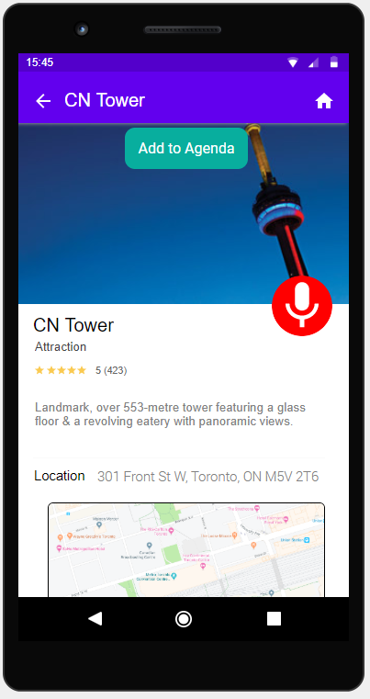
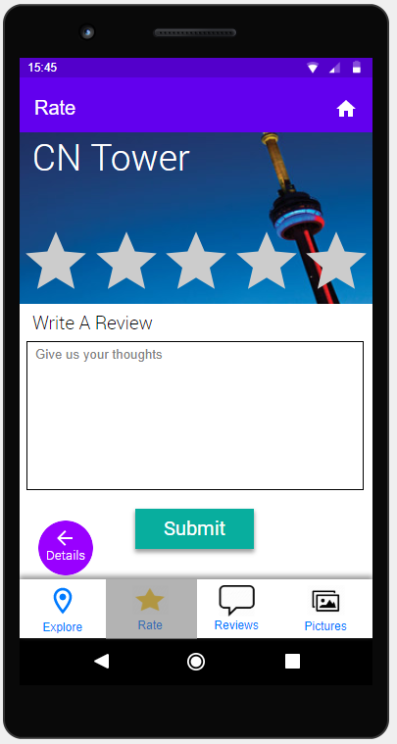
Tasks
Planning the Trip
During the Trip
After the Trip
Notes:
Based on the feedback from the survey, we decided that it would be best to design our prototype in such a way to simulate the 3 key features that users will be interacting with before, during, and after their trip.

Slide 12
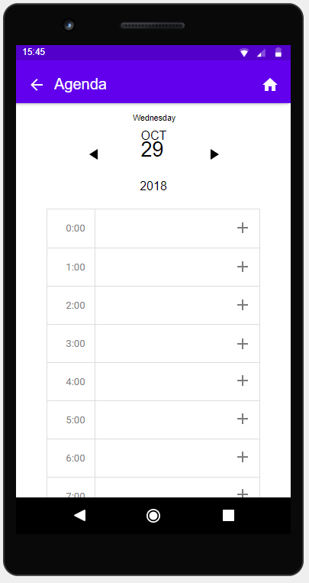
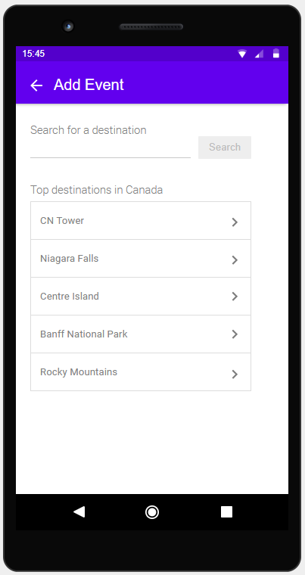
Creating a Travel Plan
Notes:
In the planning phase, users will be prompted to enter their tentative plans on when and generally where they plan to travel to, as seen on the first screen on the very left.
The user will then be taken to their travel agenda which they can navigate using the arrows at the top and fill in with their daily plans by tapping the + buttons under the timeslots.
After tapping the + button, the user will be able to search for a destination or based off of the general location the user plans to travel to as inputted in the first screen, recommendations will be provided to the user.

Slide 13
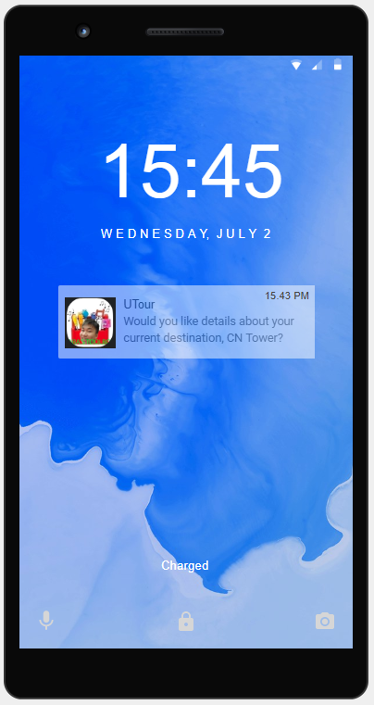
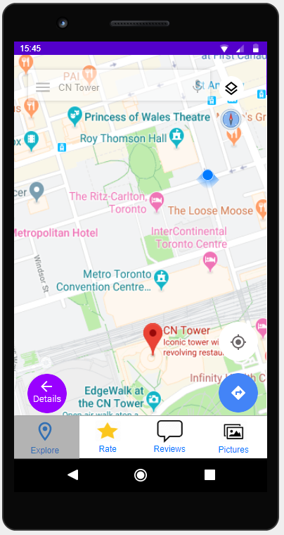
Learning About a Destination
Notes:
When the user is at a destination at the time as planned in their agenda, which could be detected through the device’s location services, the user will receive a notification on their device which prompts them to learn more about this destination, in this case, the CN Tower.
When tapped, the user will be taken to the destination’s details page where a picture of the attraction will be present as the header. On this screen, the user can see how well others have rated the attraction and they can explore the general vicinity around the attraction using the map.
Lastly and most importantly, there is a section of the page dedicated to a detailed description of the attraction which users have the option to read or actually listen to by clicking the big red button with the voice icon.

Slide 14
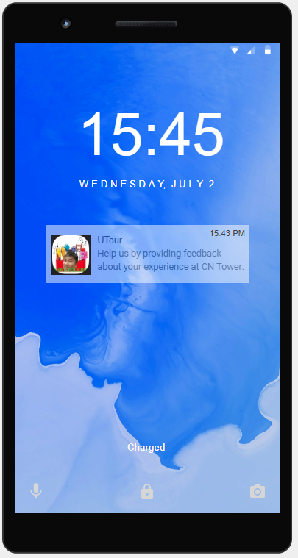
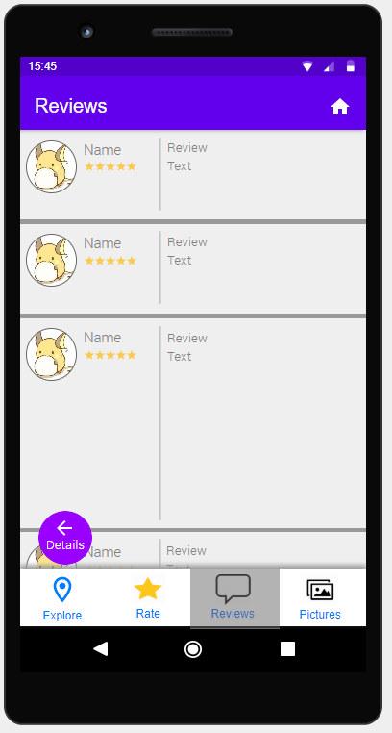
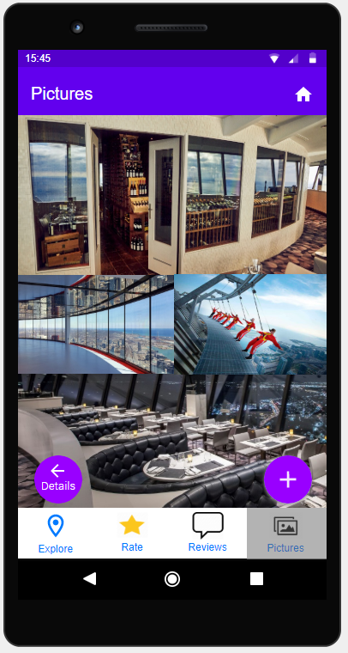
Provide Feedback About Your Experience
Notes:
Now after the user is done visiting a destination, they will receive another notification which asks them if they would like to leave some feedback about the attraction. As you can guess, the main purpose of this feature is for users to help out future travellers when THEY are planning out their trips.
Once the notification is tapped, the user will be brought to the ratings screen where they can leave a rating from 1 to 5 stars as well as write a review.
Upon submission, the user will be brought to the reviews screen where they can see what others had to say about this attraction.
Users may also click the pictures tab on the bottom navigation bar to be brought to the pictures screen. This is where the user can see what the attraction looks like through pictures that other users have uploaded as well as upload their own.
Overall, our prototype was designed with the intention for testers to feel like they are going through the whole process of planning a trip, going on the trip, and reflecting on their trip.

Slide 15
Usability Evaluation
Notes:
Next let’s look over how our prototype performed

Slide 16



Data Gathering
Notes:
Jeff - In order to evaluate the effectiveness of our travelling app prototype, we conducted a 2-part interview sessions with 6 individual participants. We started off by asking them to complete the 3 tasks we mentioned in the previous section, asking them to think-aloud as they go through the procedures in order for us to gather accurate user data. Alongside listening to their thoughts, we observed the participant’s actions to see if we could identify any acts of hesitation or confusion to gauge any app ambiguity. After completing the tasks, we asked the participants a series of questions regarding how they felt about their experience using our prototype.

Slide 17

Overall Results
Insightful Feedback
Future Users
Improvements can be made
Overall Success
Notes:
Jeff - Overall, the results we’ve gathered were fairly consistent. Participants shared relatively similar feedbacks which provided insight on areas of improvement, for example some misleading icons on certain pages. Participants also say that, other than a few small moments, had no real issues with navigating and completing the tasks with our prototype, (which correlated with our observations during the demo). Additionally, 50% (3/6) of our participants say that our app is something they would potentially use while travelling. While 33% (2/6) of our participants say that they would prefer other alternatives apps due to their flexibility.

Slide 18


Moving Forward
Notes:
Jeff - In the end, we can consider the study a resounding success, with key information that can be taken from the results, such as what can be improved as well as which components were appreciated by the users. Moving forward, if a future prototype of our application is to be developed, an emphasis on fixing some of the flaws that were pointed out by the participants will be a key goal, ideally clearing up any and all ambiguous visuals and enhancing the app with more unique features to stand above its competitors in terms of flexibility in order to regain the 33% of users that lost interest in our prototype.

Slide 19
Thank You for Listening!
Notes:
Thank you for listening and showing your interest in UTour.

